Slide 1
LwP (contd), Nearest Neighbors
CS771: Introduction to Machine Learning
Piyush Rai

Slide 2



LwP: The Prediction Rule, Mathematically
What does the prediction rule for LwP look like mathematically?
Assume we are using Euclidean distances here
$${\left|\left|μ_{−}−x\right|\right|}^{2}={\left|\left|μ_{−}\right|\right|}^{2}+{\left|\left|x\right|\right|}^{2}−2\left\langle μ_{−},x\right\rangle$$
$$μ_{−}$$
$$μ_{+}$$
$${\left|\left|μ_{+}−x\right|\right|}^{2}={\left|\left|μ_{+}\right|\right|}^{2}+{\left|\left|x\right|\right|}^{2}−2\left\langle μ_{+},x\right\rangle$$
Test example $x$
Prediction Rule: Predict label as +1 if $f\left(x\right)={\left|\left|μ_{−}−x\right|\right|}^{2}$ $−$ ${\left|\left|μ_{+}−x\right|\right|}^{2}>0$ otherwise -1

Slide 3

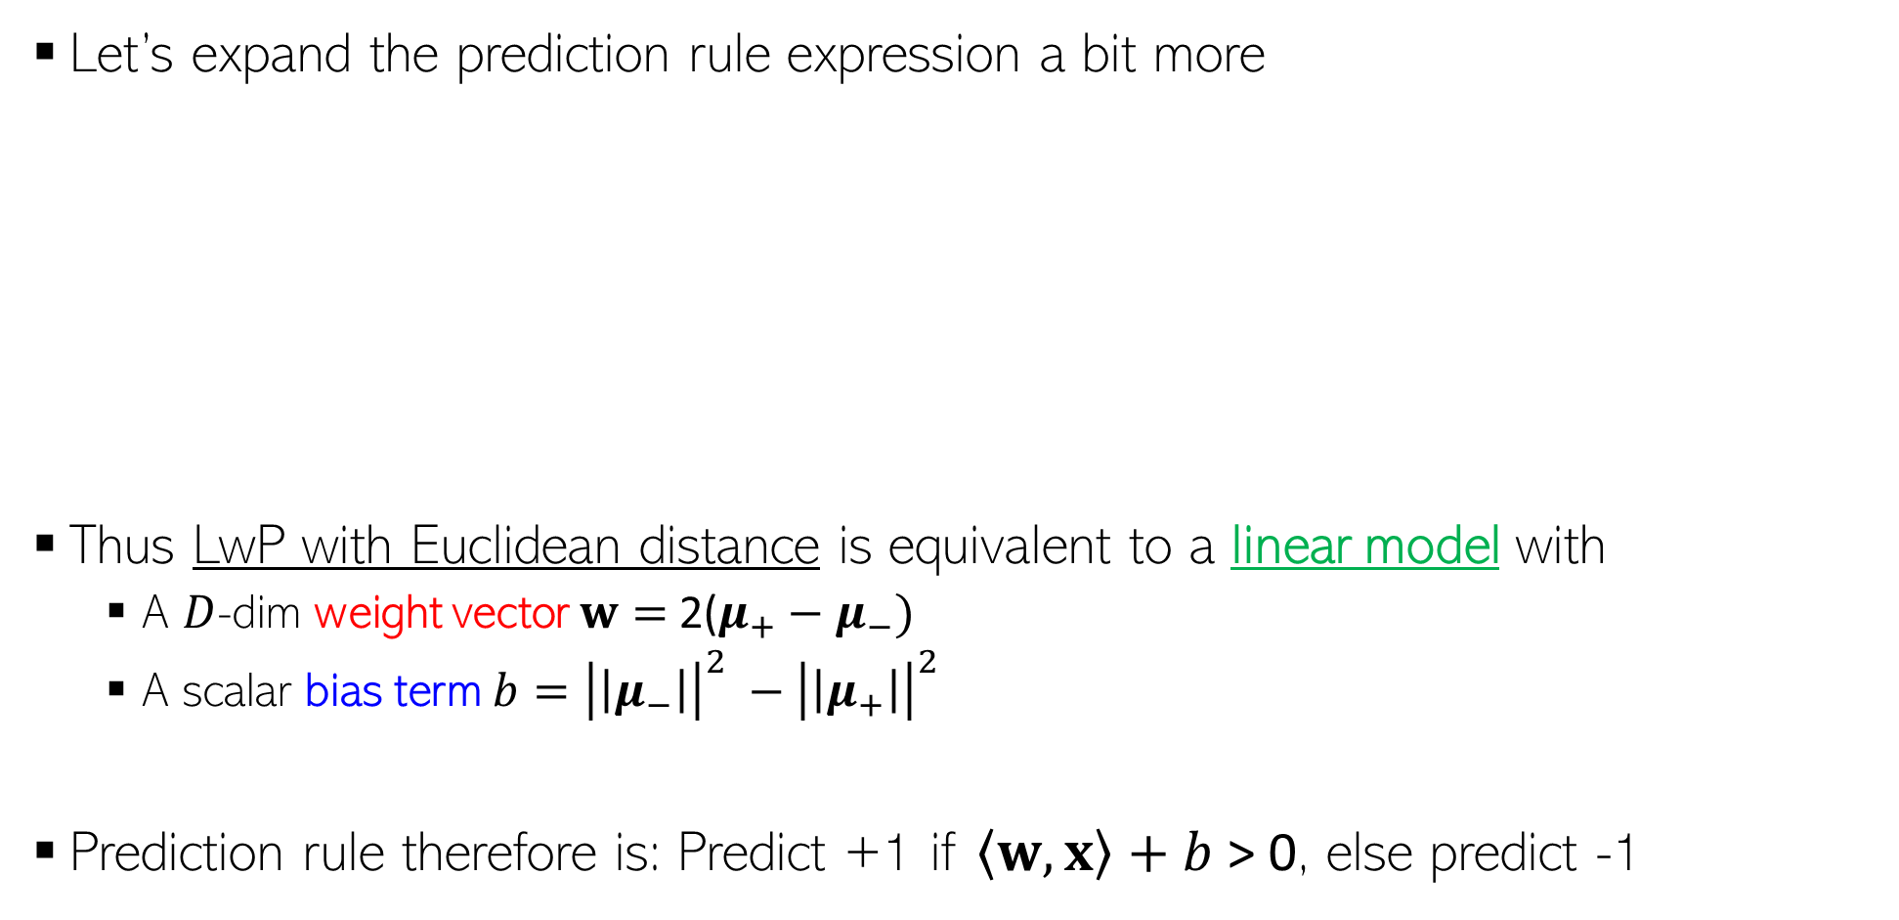
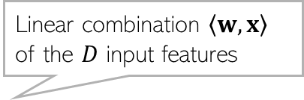
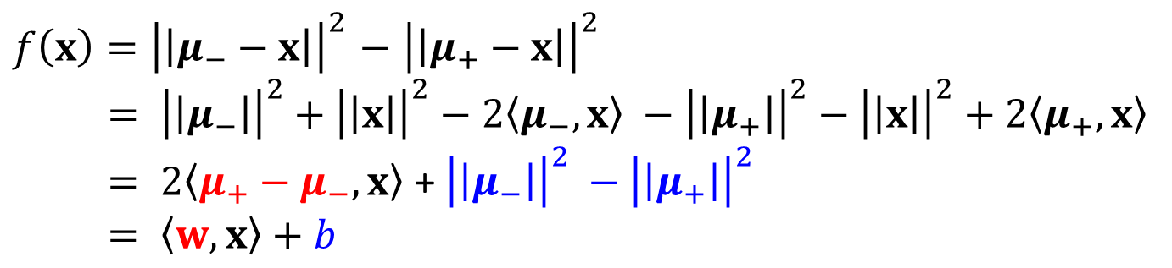
LwP: The Prediction Rule, Mathematically
Let’s expand the prediction rule expression a bit more
Thus LwP with Euclidean distance is equivalent to a linear model with
A $D$-dim weight vector $w=$2($μ_{+}−μ_{−})$
A scalar bias term $b={\left|\left|μ_{−}\right|\right|}^{2} −{\left|\left|μ_{+}\right|\right|}^{2}$
Prediction rule therefore is: Predict +1 if $\left\langle w,x\right\rangle +b$ > 0, else predict -1
$f\left(x\right)={\left|\left|μ_{−}−x\right|\right|}^{2}$ $−$ ${\left|\left|μ_{+}−x\right|\right|}^{2}$
$= {\left|\left|μ_{−}\right|\right|}^{2}+{\left|\left|x\right|\right|}^{2}−2\left\langle μ_{−},x\right\rangle −{\left|\left|μ_{+}\right|\right|}^{2}−{\left|\left|x\right|\right|}^{2}+2\left\langle μ_{+},x\right\rangle$
$= 2\left\langle μ_{+}−μ_{−},x\right\rangle$ + ${\left|\left|μ_{−}\right|\right|}^{2} −{\left|\left|μ_{+}\right|\right|}^{2}$
$= \left\langle w,x\right\rangle +b$
Linear combination $\left\langle w,x\right\rangle$ of the $D$ input features
Will look at linear models more formally and in more detail later

Slide 4



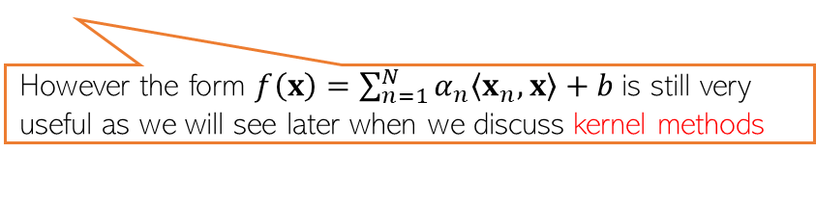
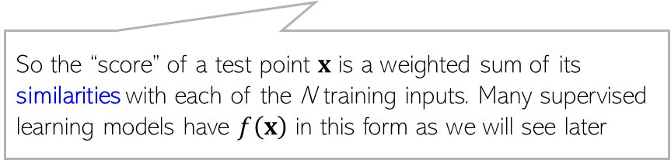

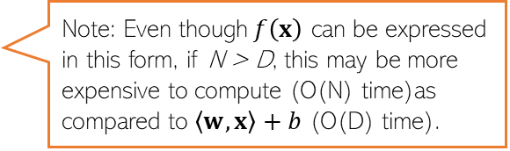
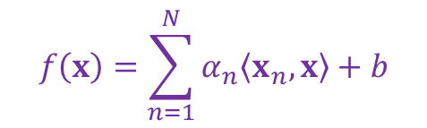
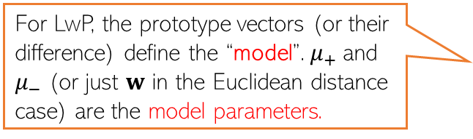



Learning with Prototypes (LwP)
$$μ_{−}= \frac{1}{N_{−}}\sum_{y_{n}=−1}{x_{n}}$$
$$μ_{+}= \frac{1}{N_{+}}\sum_{y_{n}=+1}{x_{n}}$$
$$μ_{−}$$
$$μ_{+}$$
$$w$$
$$w=μ_{+} −μ_{−}$$
Prediction rule for LwP (for binary classification with Euclidean distance)
If Euclidean distance used
$f\left(x\right)= 2\left\langle μ_{+}−μ_{−},x\right\rangle$ + ${\left|\left|μ_{−}\right|\right|}^{2} −{\left|\left|μ_{+}\right|\right|}^{2}= \left\langle w,x\right\rangle +b$
For LwP, the prototype vectors (or their difference) define the “model”. $μ_{+}$and $μ_{−}$ (or just $w$ in the Euclidean distance case) are the model parameters.
Decision boundary
(perpendicular bisector of line joining the class prototype vectors)
($f\left(x\right)$> 0 then predict +1 otherwise -1)
Exercise: Show that for the bin. classfn case
$$f\left(x\right)=\sum_{n=1}^{N}{α_{n}\left\langle x_{n},x\right\rangle +b}$$
Note: Even though$f\left(x\right)$ can be expressed in this form, if N > D, this may be more expensive to compute (O(N) time)as compared to $\left\langle w,x\right\rangle +b$ (O(D) time).
Can throw away training data after computing the prototypes and just need to keep the model parameters for the test time in such “parametric” models
So the “score” of a test point $x$ is a weighted sum of its similarities with each of the N training inputs. Many supervised learning models have $f\left(x\right)$ in this form as we will see later
However the form $f\left(x\right)=\sum_{n=1}^{N}{α_{n}\left\langle x_{n},x\right\rangle +b}$is still very useful as we will see later when we discuss kernel methods

Slide 5



LwP: Some Failure Cases
Here is a case where LwP with Euclidean distance may not work well
In general, if classes are not equisized and spherical, LwP with Euclidean distance will usually not work well (but improvements possible if features are learned, e.g., using distance metric learning methods or deep learning)
Can also use a Mahalanobis distance to handle such cases, or use probabilistic models that represent each class not by a “point” (its mean) but as a probability distribution like a Gaussian
$$μ_{−}$$
$$μ_{+}$$
Will study such approaches later
Test example $x$

Slide 6
LwP: Some Concluding Remarks
Very simple, interpretable, and lightweight model
Just requires computing and storing the class prototype vectors
Works with any number of classes (thus for multi-class classification as well)
Can be generalized in various ways to improve it further, e.g.,
Modeling each class by a probability distribution rather than just a prototype vector
Using distances other than the standard Euclidean distance (e.g., Mahalanobis)
Only applicable for classification problems (not for regression)

Slide 7
Nearest Neighbors

Slide 8

Nearest Neighbors
Wait. Did you say distances from ALL the training points? That’s gonna be sooooo expensive! ☹
Very simple idea. Simply do the following at test time
Compute distances of the test point from all the training inputs
Sort the distances to find the “nearest” input(s) in training data
Predict the label using majority or avg label of these inputs
Note: Can work with similarities as well instead of distances
Can use Euclidean or other dist (e.g., Mahalanobis). Choice imp just like LwP
Unlike LwP which does prototype based comparison, nearest neighbors method looks at the labels of individual training inputs to make prediction
Applicable to both classifn as well as regression (LwP only works for classifn)
Yes, but let’s not worry about that at the moment. There are ways to speed up this step

Slide 9
Nearest Neighbors for Classification

Slide 10

Nearest Neighbor (or “One” Nearest Neighbor)
Decision boundary
Interesting. Even with Euclidean distances, it can learn nonlinear decision boundaries?
Indeed. And that’s possible since it is a “local” method (looks at a local neighborhood of the test point to make prediction)
Nearest neighbour approach induces a Voronoi tessellation/partition of the input space (all test points falling in a cell will get the label of the training input in that cell)
Test point
Test point

Slide 11



K Nearest Neighbors (KNN)
In many cases, it helps to look at not one but $K$ > 1 nearest neighbors
Essentially, taking more votes helps!
Also leads to smoother decision boundaries (less chances of overfitting on training data)
$K$ = 1
Test input
$K$ = 3
How to pick the “right” K value?
K is this model’s “hyperparameter”. One way to choose it is using “cross-validation” (will see shortly)
Also, K should ideally be an odd number to avoid ties

Slide 12
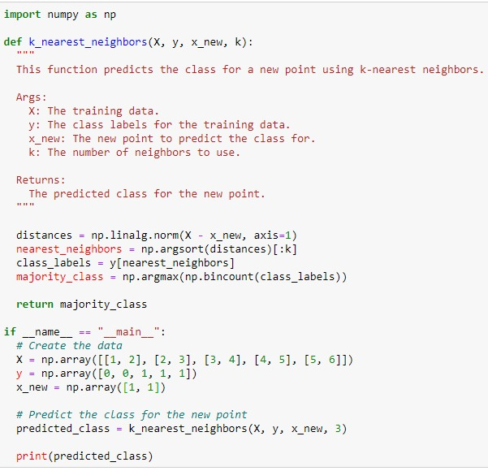
KNN in Python (NumPy) Code

Slide 13
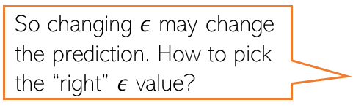
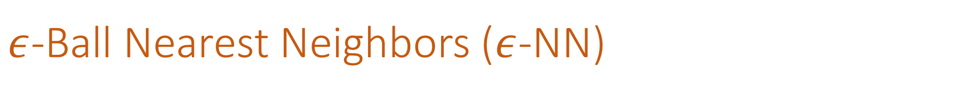

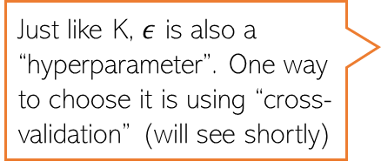
$ε$-Ball Nearest Neighbors ($ε$-NN)
Rather than looking at a fixed number $K$ of neighbors, can look inside a ball of a given radius $ε$, around the test input
So changing $ε$ may change the prediction. How to pick the “right” $ε$ value?
Test input
Just like K, $ε$ is also a “hyperparameter”. One way to choose it is using “cross-validation” (will see shortly)

Slide 14







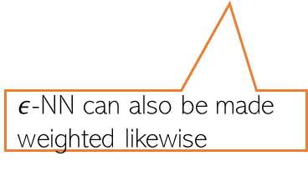
Distance-weighted KNN and $ε$-NN
The standard KNN and 𝜖-NN treat all nearest neighbors equally (all vote equally)
An improvement: When voting, give more importance to closer training inputs
$K$ = 3
Test input
$$\frac{1}{3}$$
+
$$\frac{1}{3}$$
+
$$\frac{1}{3}$$
=
In weighted approach, a single red training input is being given 3 times more importance than the other two green inputs since it is sort of “three times” closer to the test input than the other two green inputs
Unweighted KNN prediction:
$$\frac{3}{5}$$
+
$$\frac{1}{5}$$
+
$$\frac{1}{5}$$
=
Weighted KNN prediction:
$ε$-NN can also be made weighted likewise

Slide 15
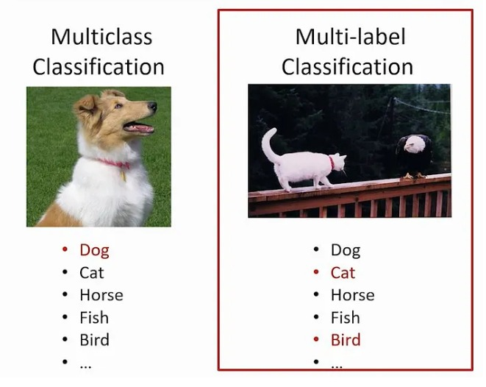
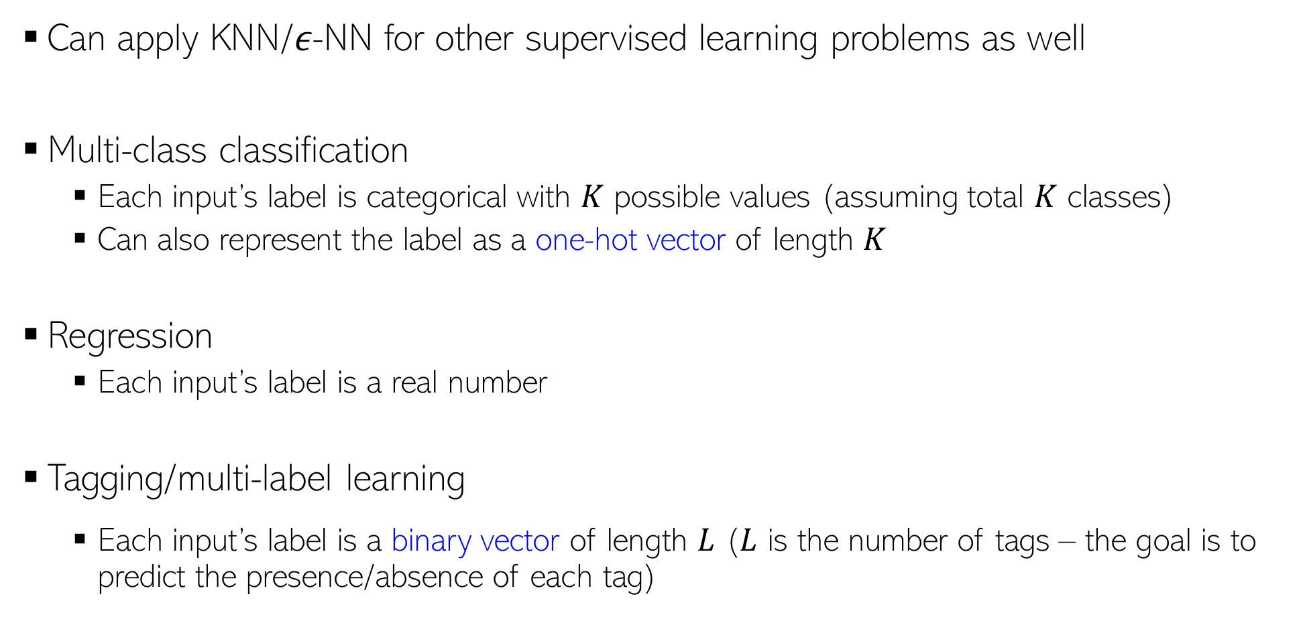
KNN/$ε$-NN for Other Supervised Learning Problems
Can apply KNN/𝜖-NN for other supervised learning problems as well
Multi-class classification
Each input’s label is categorical with $K$ possible values (assuming total $K$ classes)
Can also represent the label as a one-hot vector of length $K$
Regression
Each input’s label is a real number
Tagging/multi-label learning
Each input’s label is a binary vector of length $L$ ($L$ is the number of tags – the goal is to predict the presence/absence of each tag)
Assuming discrete/categorical labels with 5 possible values, the one-hot representation will be an all zeros vector of size 5, except a single 1 denoting the value of the discrete label, e.g., if label = 3 then one-hot vector = [0,0,1,0,0]
Pic source: https://www.microsoft.com/en-us/research/uploads/prod/2017/12/40250.jpg

Slide 16
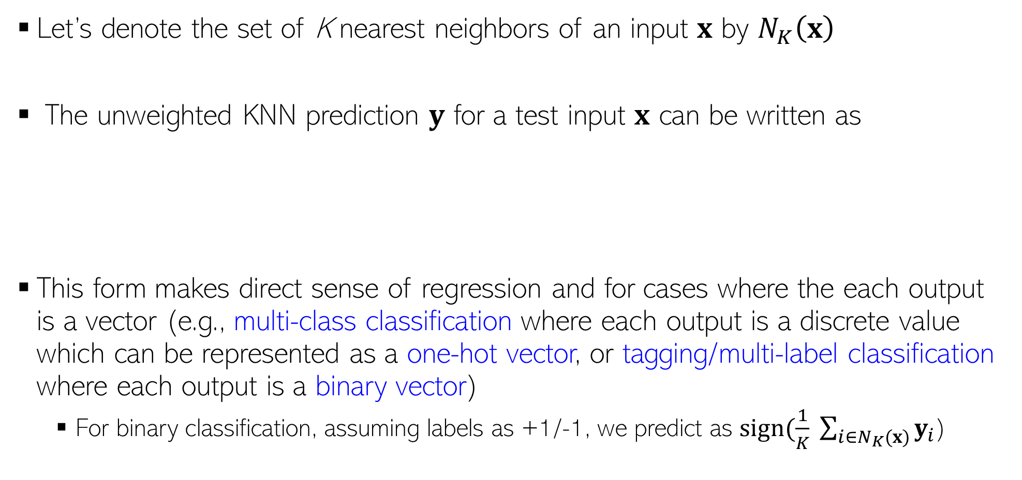

KNN Prediction Rule: The Mathematical Form
Let’s denote the set of K nearest neighbors of an input $x$ by $N_{K}\left(x\right)$
The unweighted KNN prediction $y$ for a test input $x$ can be written as
This form makes direct sense of regression and for cases where the each output is a vector (e.g., multi-class classification where each output is a discrete value which can be represented as a one-hot vector, or tagging/multi-label classification where each output is a binary vector)
For binary classification, assuming labels as +1/-1, we predict as $sign(\frac{1}{K} \sum_{i∈N_{K}(x)}{y_{i}}$)
$$y= \frac{1}{K} \sum_{i∈N_{K}(x)}{y_{i}}$$

Slide 17
Nearest Neighbors: Some Comments
An old, classic but still very widely used algorithm
Can sometimes give deep neural networks a run for their money ☺
Can work very well in practical with the right distance function
Comes with very nice theoretical guarantees
Also called a memory-based or instance-based or non-parametric method
No “model” is learned here (unlike LwP). Prediction step uses all the training data
Requires lots of storage (need to keep all the training data at test time)
Prediction step can be slow at test time
For each test point, need to compute its distance from all the training points
Clever data-structures or data-summarization techniques can provide speed-ups

Slide 18
Speeding-up Nearest Neighbors
Can use techniques to reduce the training set size
Several data summarization techniques exist that discard redundant training inputs
Now we will require fewer number of distance computations for each test input
Can use techniques to reduce the data dimensionality (no. of features)
Won’t reduce no. of distance computations but each distance computation will be faster
Compressing each input into a small binary vector (a type of dim-red)
Distance/similarity computation between bin. vecs is very fast (can even be done in H/W)
Various other techniques as well, e.g.,
Locality Sensitive Hashing (group training inputs into buckets)
Clever data structures (e.g., k-D trees) to organize training inputs
Use a divide-and-conquer type approach to narrow down the search region
We will look at Decision Trees which is also like a divide-and-conquer approach

Slide 19


Hyperparameter Selection
Every ML model has some hyperparameters that need to be tuned, e.g.,
K in KNN or $ε$ in $ε$-NN
Choice of distance to use in LwP or nearest neighbors
Would like to choose h.p. values that would give best performance on test data
Oops, sorry! What to do then?
Okay. So I can try multiple hyperparam values and choose the one that gives the best accuracy on the test data. Simple, isn’t it?
Beware. You are committing a crime. Never Ever touch your test data while building the model
Use cross-validation – use a part of your training data (we will call it “validation/held-out set”) to select best hyperparam values.
Is validation set a good proxy to test set?
Usually yes since training set (from which the val set is taken) and test sets are assumed to have similar distribution)

Slide 20
Cross-Validation
No peeking while building the model
Training Set (assuming bin. class. problem)
Test Set
Note: Not just h.p. selection; we can also use CV to pick the best ML model from a set of different ML models (e.g., say we have to pick between two models we may have trained - LwP and nearest neighbors. Can use CV to choose the better one.
Class 1
Class 2
Actual Training Set
Randomly Split
Validation Set
Randomly split the original training data into actual training set and validation set. Using the actual training set, train several times, each time using a different value of the hyperparam. Pick the hyperparam value that gives best accuracy on the validation set
What if the random split is unlucky (i.e., validation data is not like test data)?
If you fear an unlucky split, try multiple splits. Pick the hyperparam value that gives the best average CV accuracy across all such splits. If you are using N splits, this is called N–fold cross validation

Slide 21
Next Class
21
Decision Trees and Forests

